Slide 1




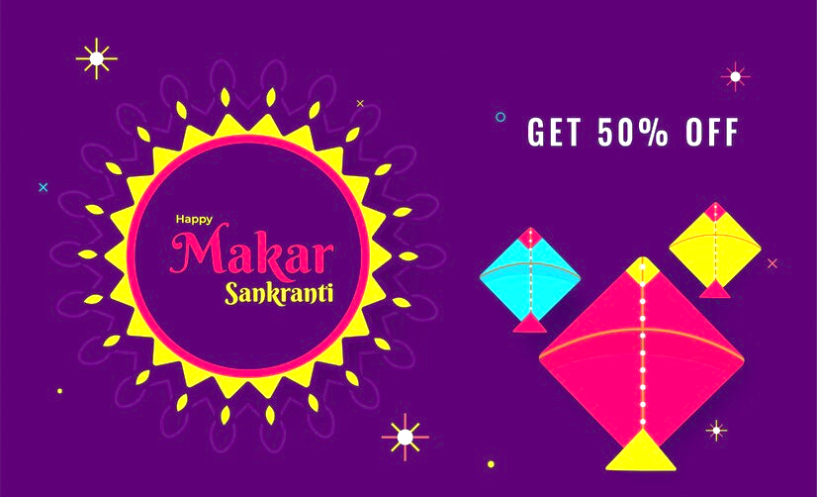
ATLIQ MART SALES & PROMO ANALYSIS

Slide 2
Table of Contents
Atliq Mart - Introduction
Market Share by City
Revenue before & after Promo city-wise
Store Performance Analysis
Promotion Type Analysis
Revenue Share by Promo Type
Product and Category Analysis
Business Request
Recommendations

Slide 3
Atliq Mart - Introduction
AtliQ Mart is a retail giant with over 50 supermarkets in the southern region of India.
All their 50 stores ran a massive promotion during the Diwali 2023 and Sankranti 2024 on their AtliQ branded products.
The problem statement is to understand which promotions did well and which did not to make informed decisions for their next promotional period.
During this promotion, following offers were given for Combo1, Home Appliances, Grocery Staples, Home Care, Personal Care.
25% Off
33% Off
50% Off
500 Cashback
BOGOF

Slide 4
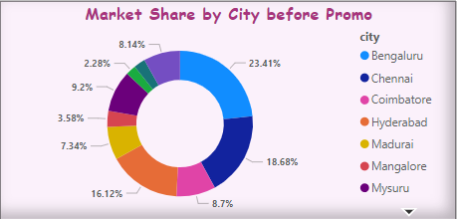
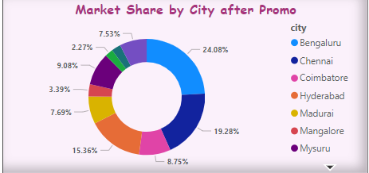
Market Share by City
Market Share defines the percentage of share each city holds.
In both before and after promotion 3 cities hold around 60% of market share.
Though the sales of Hyderabad has seen 200% increase in IR however market share decreased 0.76%.
Chennai and Madurai are the only cities having more than 30% market share in both ISU and IR.
Rank | Market Share Before | Market Share After
Highest | 23.41% (Bengaluru) | 24.08% (Bengaluru)
Lowest | 2.28% (Trivandrum) | 2.27% (Trivandrum)

Slide 5
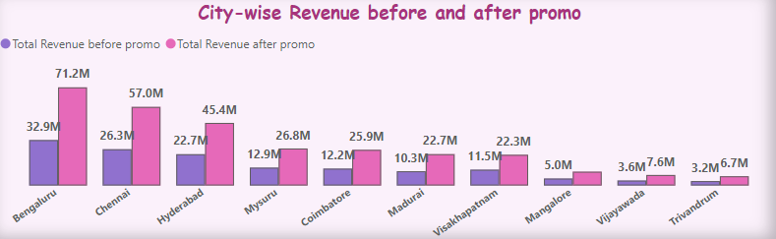
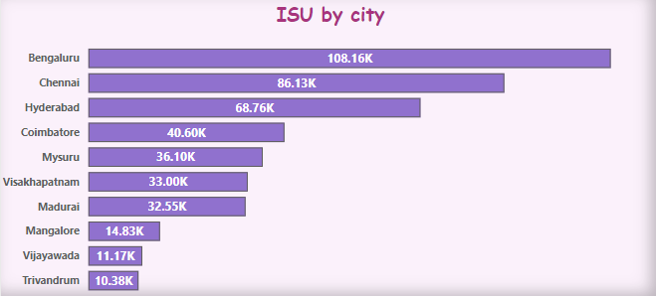
Revenue before & after Promo city-wise
The Incremental Revenue(IR) is given by,
IR = Total Revenue after promotion - Total Revenue before promotion
Promotion of products was effective and resulted more than 200% of sales in most of the cities.
Bengaluru has secured top in highest IR of 38M.
Trivandrum has the least sales of 6.9M with 3.4M IR.
Madurai being a tier-2 city has drastic growth of 220% which is top among all the cities.
ISU by City
The Incremental Sold Units(ISU) is given by,
ISU = Total Units Sold after promotion - Total Units Sold before promotion
Bengaluru (24.5%), Chennai, Hyderabad contributed to nearly 60% of the ISU during promotions.
Trivandrum(2.35%), Vijayawada, Mangalore contributed to less than 5% of the ISU during both the promotions.

Slide 6
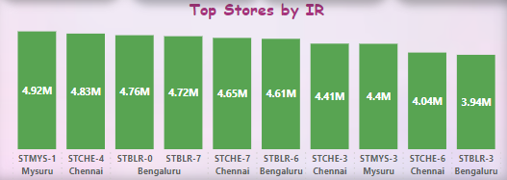
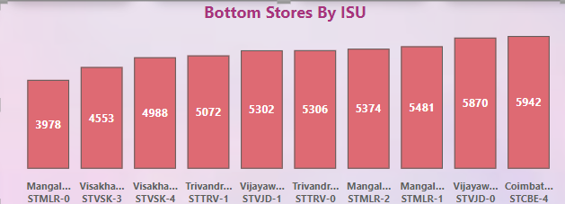
Store Performance Analysis
Bengaluru and Chennai stores outperformed other cities, 4 stores from each city ranks in top 10 based on IR.
Tier-2 Cities Mangalore and Vishakhapatnam has the lowest performing stores in terms of ISU.
Ironically, Tier-2 City Mysore holds Top in IR.
500 Cashback and BOGOF are the common promos having most sales across all stores.

Slide 7
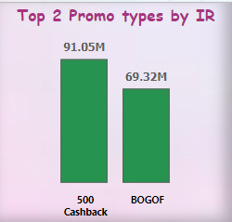
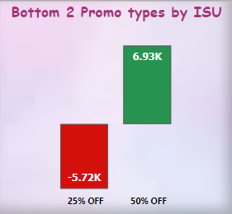
Promotion Type Analysis
The Top 2 Promotion types contributed highest Incremental Revenue are
500 Cashback (IR of 91.05 M)
BOGOF (IR of 69.32 M )
During Sankranti, “BOGOF” (IR of 53.48M) outperformed “500 Cashback” (IR of 14.5M) .
While the case is reverse in terms of the Diwali campaign i.e. “500 Cashback” (IR of 76.55M) and “BOGOF” (IR of 15.84M) .
Least performed promos are “25% OFF” (-5.72 K) and “50% OFF” (6.93 K), meaning the sales of products under these offers were comparatively lesser before promotions.
During Sankranti,”25% OFF” had an Decremental Sales of -1.19K and -4.53K in Diwali.

Slide 8
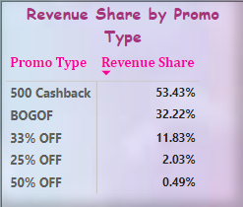
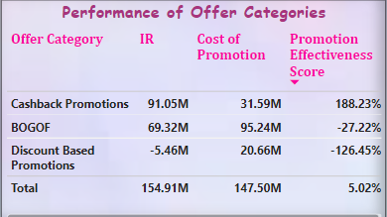
Revenue Share by Promo Type
The Revenue Share by promo type is given by,
Revenue Share % = (Revenue generated by the promo type/Total Revenue generated from all promo types)*100
“500 Cashback” holds the highest revenue share of 53.43 % while 50% OFF holds the least of 0.49 %.
Promo Performance | Diwali | Sankaranti
Highest | 500 Cashback (74%) | BOGOF (58.72%)
Lowest | 50% OFF (0.63%) | 25% Cashback (0.29%)
PES by Promo Type
Promotion Effectiveness Score which is given by,
Promotion Effectiveness Score (PES) = ((IR – Cost of Promotion)/Cost of Promotion) * 100
“Cashback Promotions”, though have a higher cost of promotion has the highest PES which means more effective the promotion has been in terms of sales.
“Cashback Promotions” has contributed to 201.56% in Diwali and 133.72% in Sankaranti, resulting higher Return on Investment (ROI).
“BOGOF”,”Discount Based Promotions” have –ve PES i.e. cost of promotions exceeded the revenue generated.

Slide 9
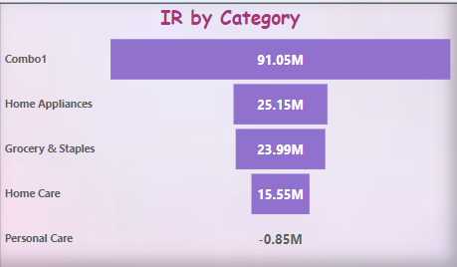
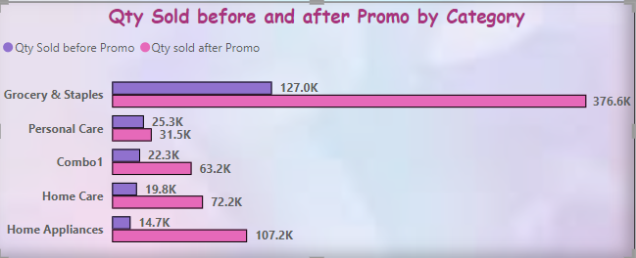
Product and Category Analysis
Atliq_Farm_Chakki_Atta (1KG) is the highest sold product with with 49K ISU and Atliq_Home_Essential_8_Product_Combo is 2nd by selling almost 41K units.
Scrub Sponge for Dishwash & Fusion Container were performing well without promos or offers.
“Atliq_Home_Essential_8_Product_Combo” of “Combo1” had highest IR of 91.05M out of which 83% sales generated from Diwali sales while “Personal Care” had decremental sales of 0.85M.
“Grocery & Staples” has contributed to nearly 40% of IR generated from Sankranti sales.
“Personal Care” has only generated decremental revenue in both the campaigns.
“Grocery & Staples” has contributed to nearly 72% increase of sold units during Sankranti while only nearly 10% increase during Diwali thereby contributing to 56.5% in total.

Slide 10
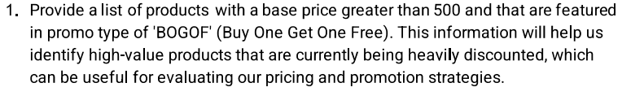
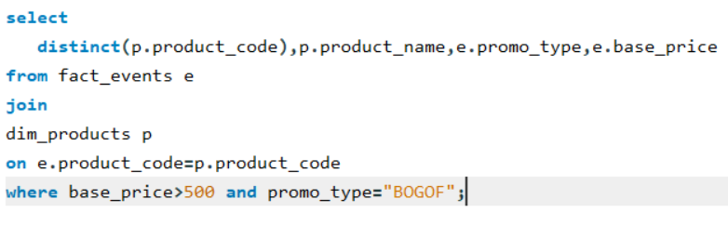
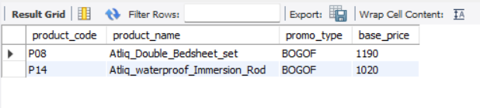
Business Requests

Slide 11
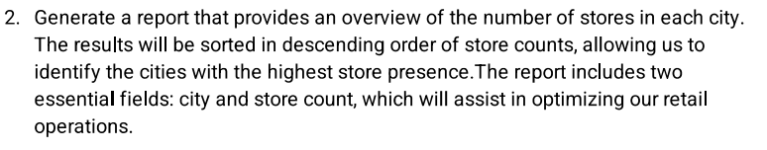
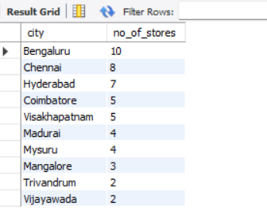
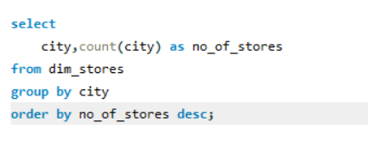

Slide 12
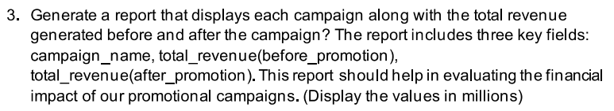
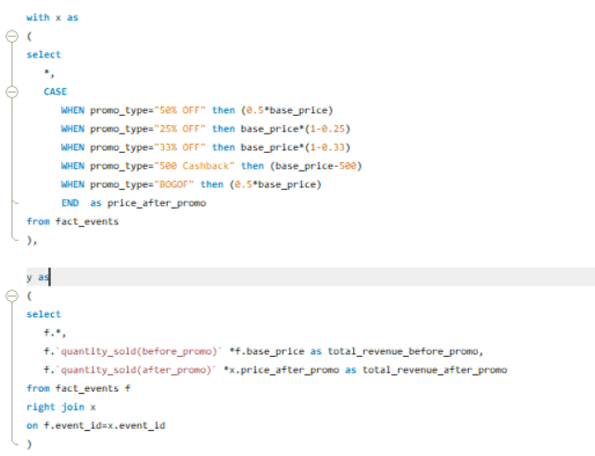
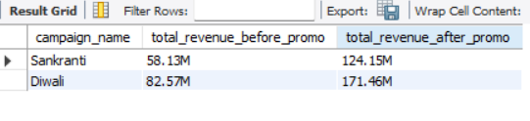
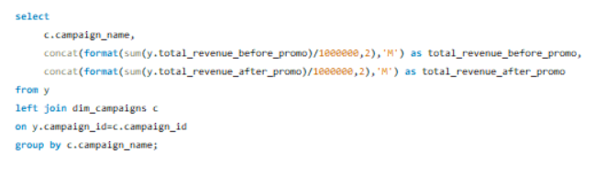

Slide 13
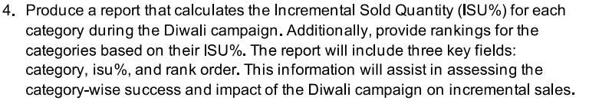
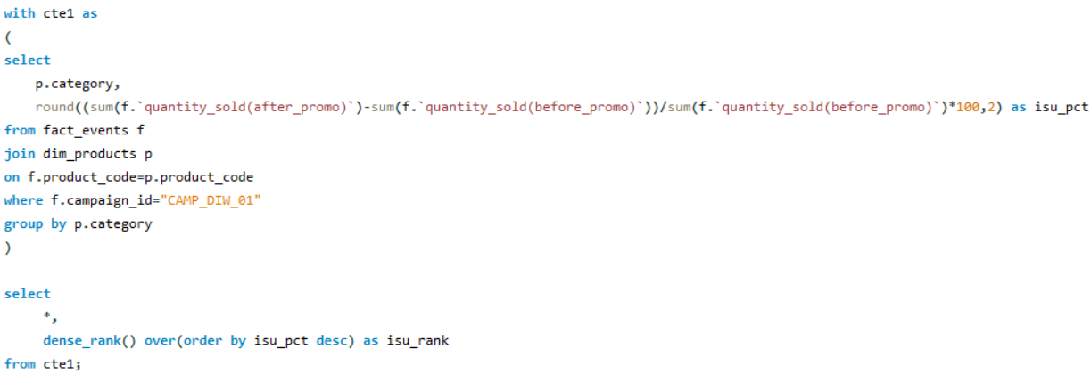
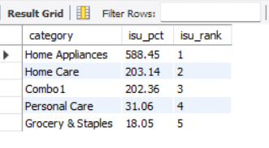

Slide 14
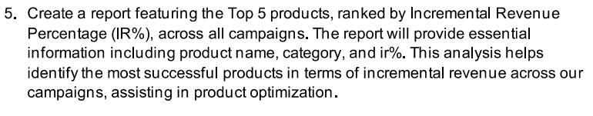
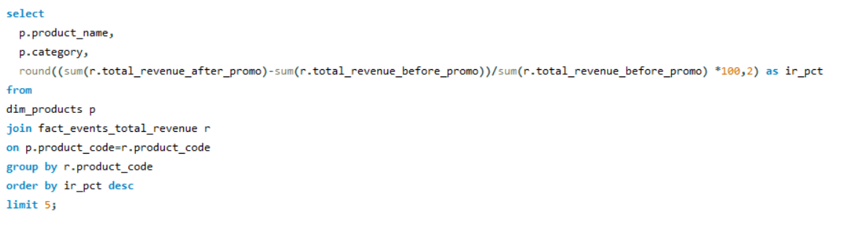
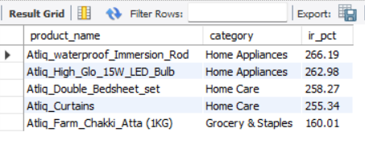

Slide 15
Recommendations
Expansion of stores across all the cities .
500 Cashabck or BOGOF offers for Personal care and Home care category to boost sales.
Products Scrub Sponge for Dishwash & Fusion Container were performing well without promos or offers.
Maintaining high inventory for the products such Chakki Atta and Home Essentials combo which are highest selling during promotions.

